Slide 1
Leading Learning That Matters Setting Hearts on Fire
Chris Hayes
Xavier College
ISV & Harvard’s Project Zero

Slide 2
Action Research Project
How does one set hearts on fire for a learning that matters at Xavier College?
How do you create, allow and promote opportunities for learners and teachers to be engaged and challenged in a passionate thirst for learning?
What will learning look like, how will it be delivered and what will be the outcome of the learning?
How do you operationalise the Vision, Mission and Guiding Principles of the College so that the learning is a real and tangible example of engagement and challenge leading to deep learning?

Slide 3
Leading Learning that Matters
How can I shape an institution that stays true to its core commitments, thrives as a contemporary centre of learning and contributes to forming women and men for others?
Protecting and sustaining progress
Fostering individual development
Designing collaborative structures
Creating a shared vision

Slide 4
Vision Statement
Xavier College aspires to set hearts on fire by an educational commitment to a faith that does justice.

Slide 5
Mission Statement
Xavier College is a Catholic school within the spiritual and educational tradition of The Society of Jesus (the Jesuits). Our inspiration is Jesus Christ, the model of fulfilled human life. Our aim is excellence in education, and the formation of reflective, compassionate and articulate men and women of Christian faith, hope and love who will provide outstanding service and leadership in our world.

Slide 6
Guiding Principles
Protecting, educating and developing the whole person
having a personal concern and care (Cura Personalis) for the whole life of each member of our College community
forming our students intellectually, spiritually, morally, aesthetically, physically, socially and emotionally
protecting and safeguarding the wellbeing of all students in our care
Formation of Men and Women of Faith to work for justice in the world
forming members of our community to serve God in the world
having a committed and practical concern for those in need, such that students, staff and parents make an explicit connection between their Catholic faith and their work for justice in the world

Slide 7
Guiding Principles
Pursuit of Excellence in Humanity
welcoming all to Xavier College, where they can flourish and passionately pursue excellence in all things
encouraging each person to live out his / her vocation in life by developing their God-given gifts to the best of their ability
Discernment and Wisdom
developing a self-reflective disposition in members of our community, particularly in students, preparing them to make informed decisions in accordance with their conscience
preparing the individual to find God in all things through the use of each person’s imagination and creativity, and the integration of faith and reason

Slide 8
Guiding Principles
Critical engagement with the world
courageously and respectfully engaging with world cultures and perspectives
critically pursuing a depth of learning by reflecting on experience and being moved to action
Striving for the Magis
developing a desire to strive for the magis. The Jesuit ideal of magis is a thirst for ‘depth’, for the greater good and for the most courageous response to the challenges of our time

Slide 9
Annual Themes
2013 | 2014 | 2015 | 2016

Slide 10
How does one implement Learning that Matters?
The student is at the heart of all we do
All decisions and outcomes must have the needs of the learner at the centre

Slide 11
How does one engage our students as contemplatives in action?
We have to be realistic
We must respond to changes in society, in the ways young people learn, access and retain information. Our curriculum and its delivery must be current, appropriate to our context and ultimately challenging
As teachers, we need to look for different ways of engagement, content delivery, assessment and evaluation. Again, these approaches must work with our own context and specifically with the IPP

Slide 12
Ignatian Pedagogical Paradigm
Context, Experience, Reflection, Action, Evaluation
Pastoral Care and Wellbeing
Learning beyond the classroom
Sport, Drama, Music, Ignatian Service, Outdoor Education
Pedagogy
Victorian Curriculum (VCE)
Project Zero: Creating a Culture of Thinking
Professional Learning & Companionship
Building a culture of professional learning using the AITSL standards as a framework
CoP
Communities
of Practice
Victorian
Curriculum
Capabilities
21st
Century
Learners
21st
Century
Teaching

Slide 13
Strategic Plan 2013 - 2017
Catholic Ethos
Teaching and Learning
Student Life
Staff Professional Life
Facilities and Infrastructure
Community
Governance and Management

Slide 14
Leading Learning That Matters Setting Hearts on Fire
SEQTA

Slide 15
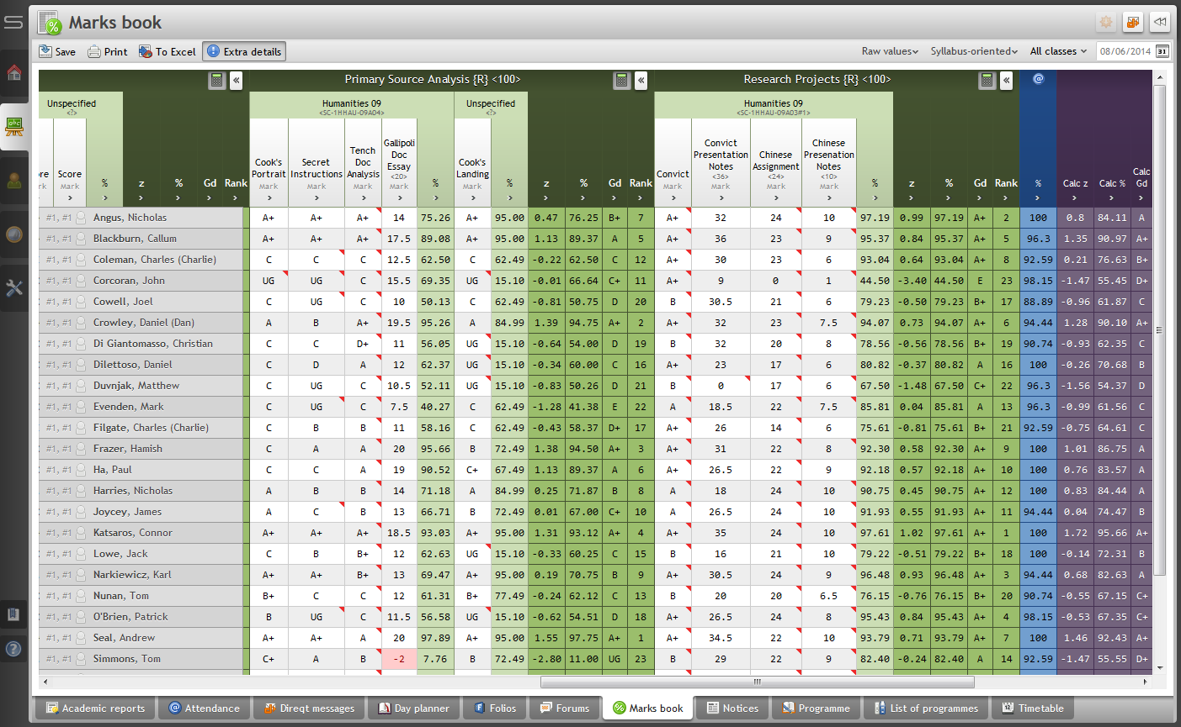
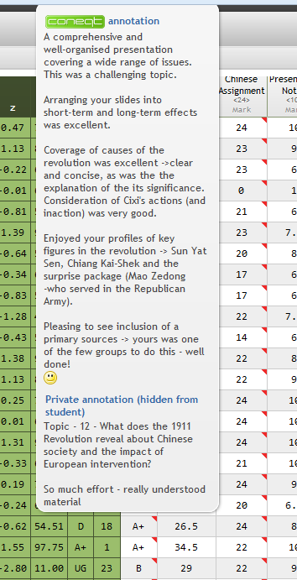
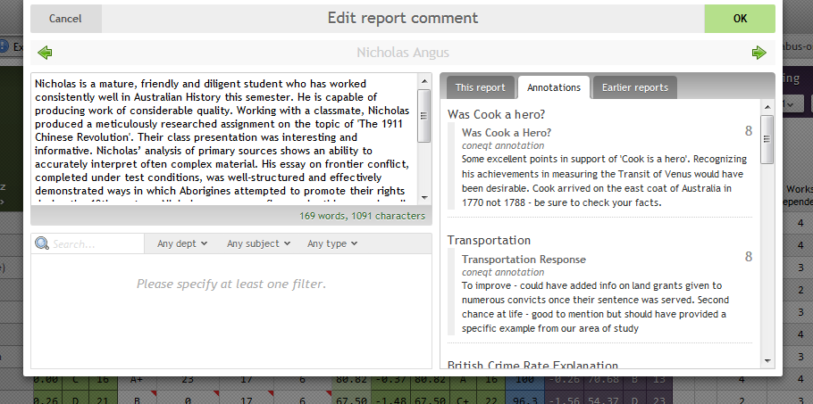
Student Work and Assessment

Slide 16
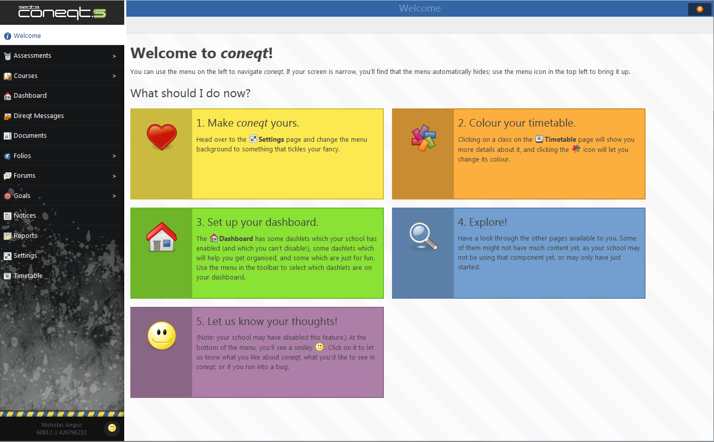
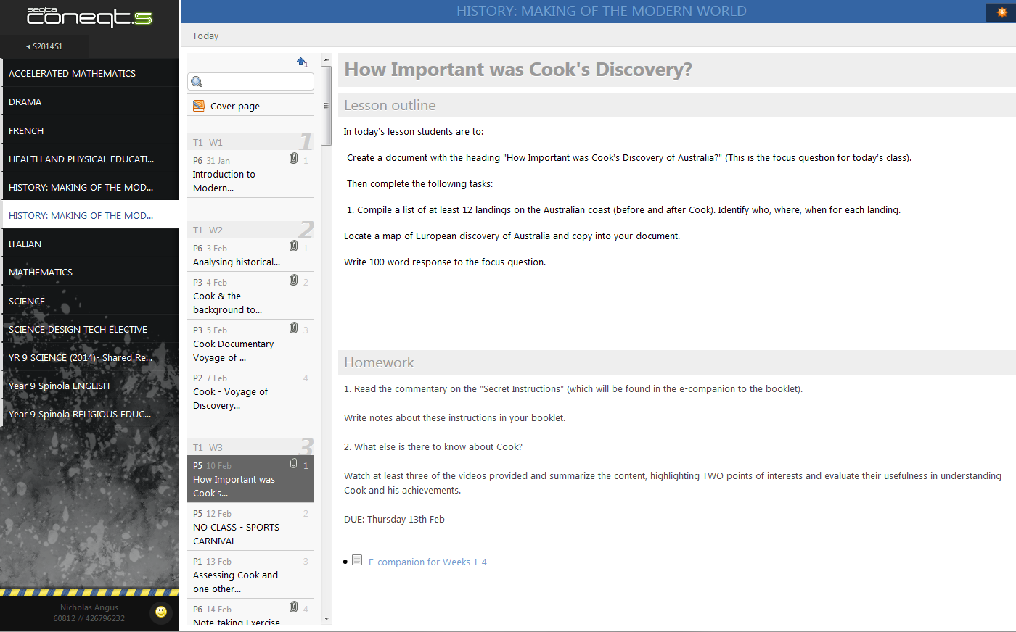
Student Interface

Slide 17
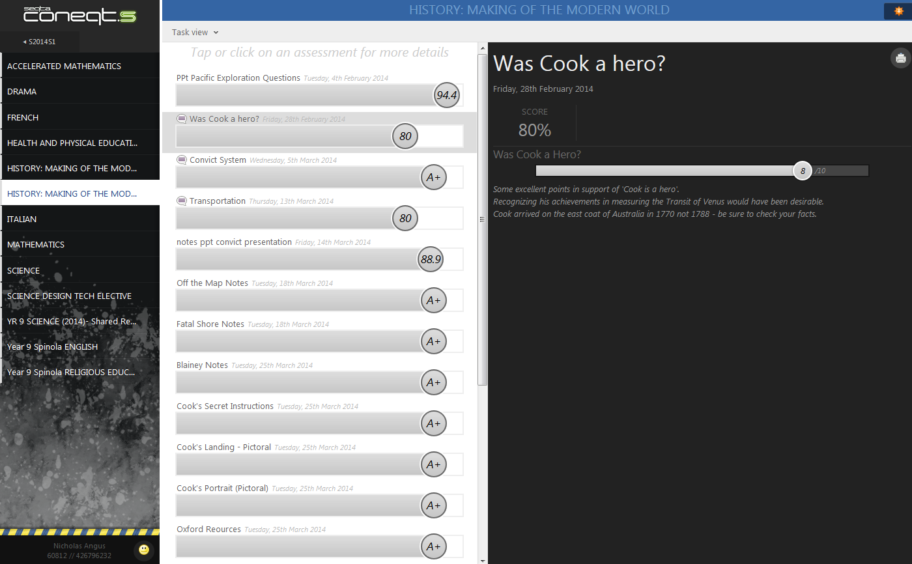
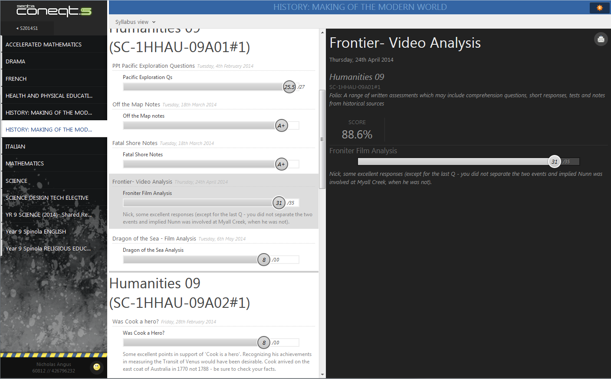
Teacher Feedback and Reflection

Slide 18
Learnings from the Project
Professor Greg Dening:
‘…a school faces a never to be resolved contradiction. It must fulfil the expectancies of those it serves if it is to survive. It must also change those expectancies if it is to be truly educational...’
Have grand plans/desires for the vision of the school
Be open and respectful of differing ways in which you can achieve the vision

Slide 19
Learnings from the Project
Build reflective practice into all aspects of decision making, planning and learning
Keep focus on the individual student
Be restless to find better ways for engagement and challenge
Build trust in the relationship – teacher/student and teacher/teacher

Slide 20
Learnings from the Project
Always be open to the conversation
“Contemplative prayer is the change that changes everything. It's not telling you what to see, but teaching you how to see. And when you know how to see, you're home free. You're indestructible. When you know how to see in a non-dualistic, holistic way, you know that it is what it is both before and after any analysis. Reality still is what it is. When you learn to surrender to that, quite frankly, you're going to be a much happier, transformed human being. And when you do work for change, your efforts will have a non-obsessive character to them” (Richard Rohr)
Fasten your seat belts and enjoy the ride!

Slide 21
Leading Learning That Matters Setting Hearts on Fire
Chris Hayes
Xavier College
ISV & Harvard’s Project Zero

