Slide 1

Non-multa sed multum
Opening prayer

Slide 2
Examen

Slide 3

Give thanks
Look at your day in a spirit of gratitude. Everything is a gift from God.
I thank you, God, for always being with me, but
especially I am grateful that you are with me right now.

Slide 4
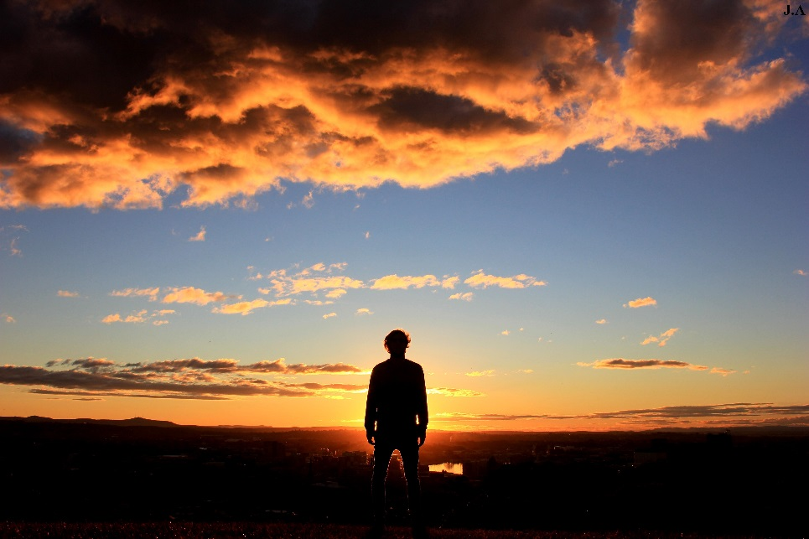
Pray for light
Ask God for the grace to pray, to see, and to understand.
God, let the Holy Spirit enlighten my mind and
warm my heart that I may know where and how we
have been together this day.

Slide 5

Review the day
Guided by the Holy Spirit, look back on your day. Pay attention to your experience. Look for God in it.
God, where have I felt your presence, seen your face, heard your word this day?
God, where have I ignored you, run from you, perhaps even rejected you this day?

Slide 6

Look at what’s wrong
God, I thank you for the times this day we have been together and we have worked together.
God, I am sorry for the ways that I have offended you by what I have done or what I did not do.
Face up to failures and shortcomings. Ask forgiveness for your faults. Ask God to show you ways to improve.

Slide 7

Resolution for the day to come
Where do you need God today? What can you do today?
God, I ask that you draw me ever closer to you this day and tomorrow.
God, you are the God of my life—thank you.

Slide 8
Pope Francis - intentions
Pope Francis has offered the Church and world a new voice.
He has been spreading the Good News like his predecessors, but has done so in a language and a style that is new, yet familiar.
Like any good Bishop, the Bishop of Rome has been teaching us.
The community for each school is encouraged to offer their intention.

Slide 9
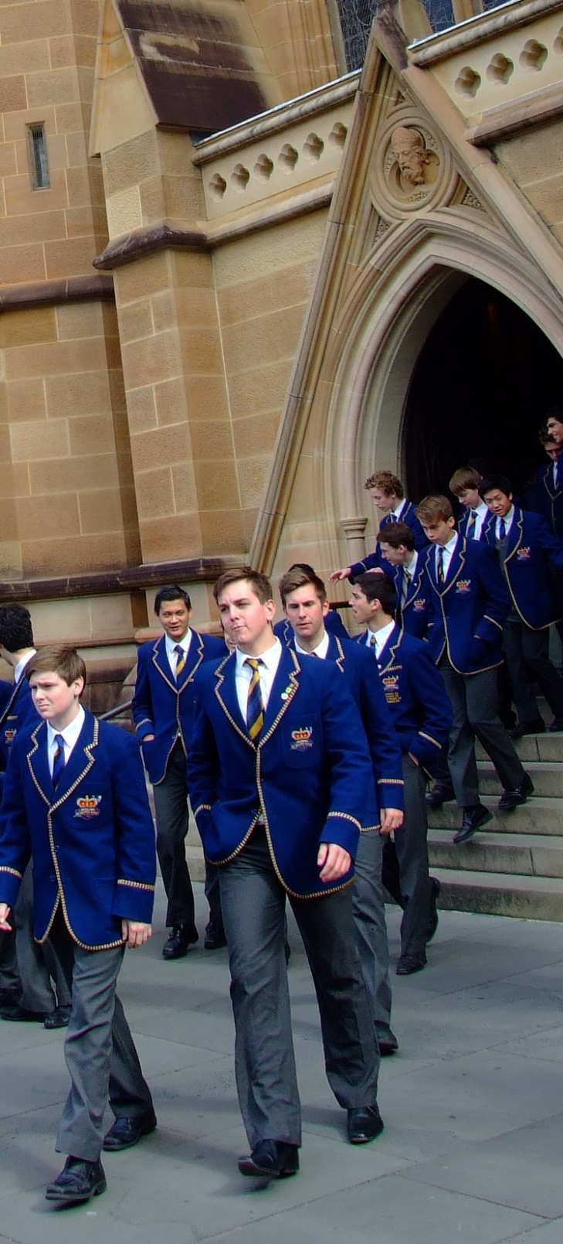



Slide 10
Intention: St Aloysius’ College
All:
Lord Hear Our Prayer
St Aloysius’ College:
Lord, we pray for our Church. That it be a field hospital, caring for the wounded.
We know that are all wounded and we all need your care and mercy.
We ask that we be instruments of your mercy in a world that so desperately needs it.
Lord Hear Us

Slide 11
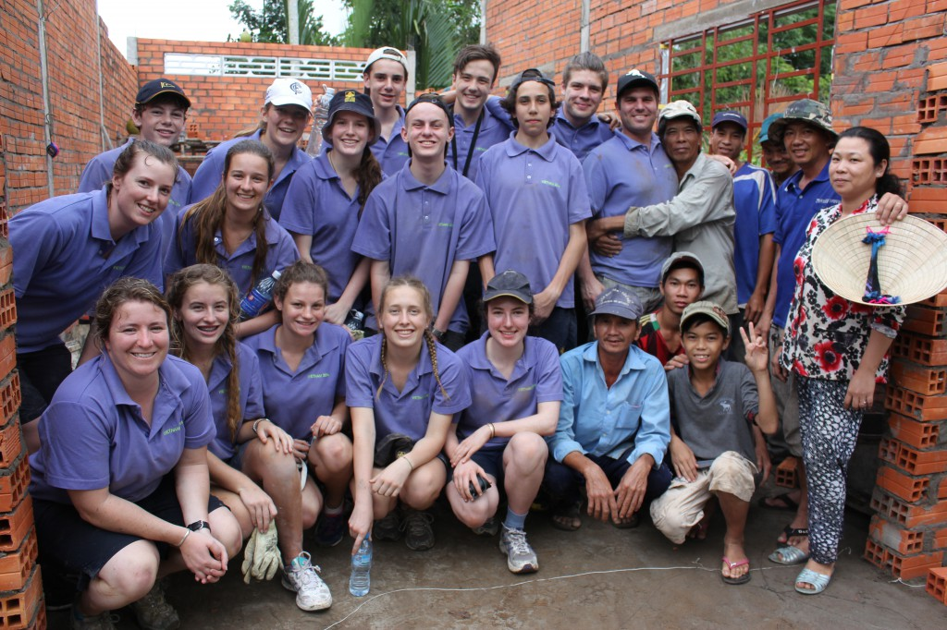

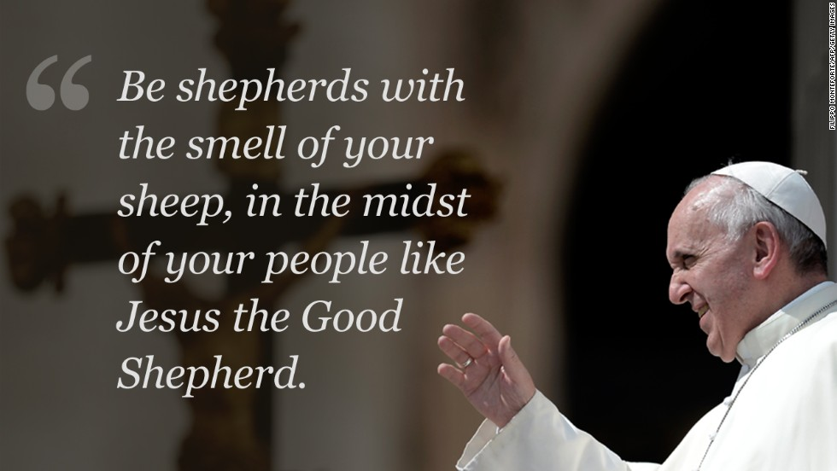

Slide 12
Intention: John XXII College
All:
Lord Hear Our Prayer
John XXIII College:
Lord, we pray that we may truly know what is to work with and for the poor.
You are King of Kings yet were born into poverty.
We ask that we be providers of charity in a world that so desperately needs it.
Lord Hear Us

Slide 13
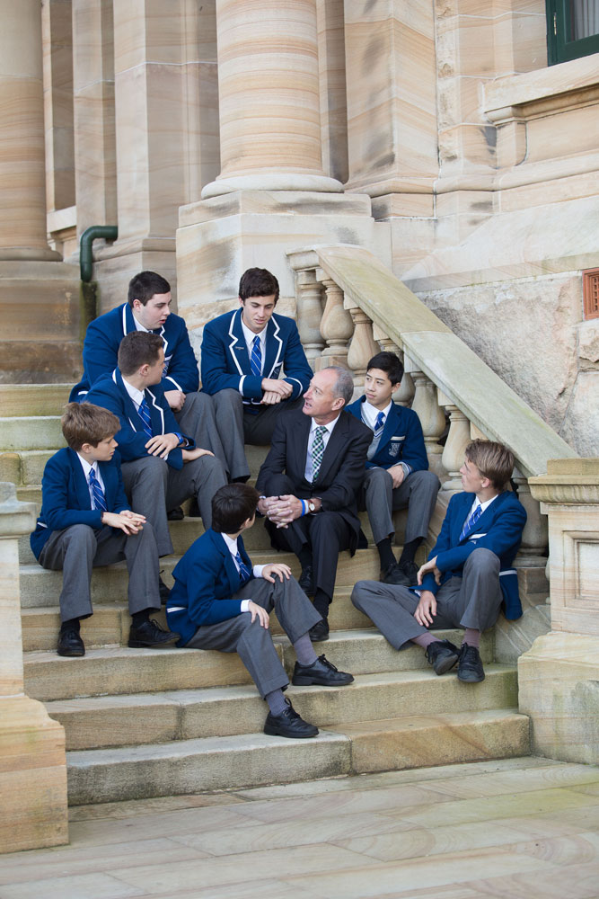
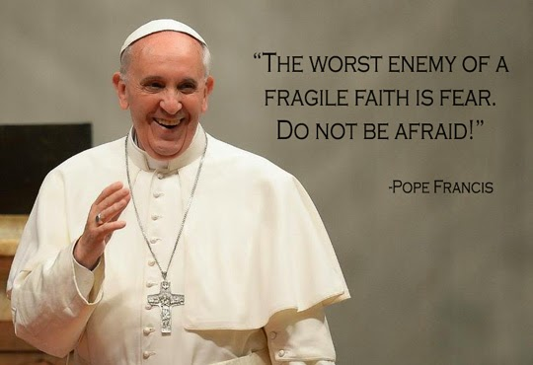


Slide 14
Intention: St Ignatius’ College, Riverview
All:
Lord Hear Our Prayer
St Ignatius’ College, Riverview:
Lord, we pray that we may overcome our fears
We know that it is fear that holds us back from being truly Christian.
We ask that we be authentically courageous in a world that so desperately needs it.
Lord Hear Us

Slide 15
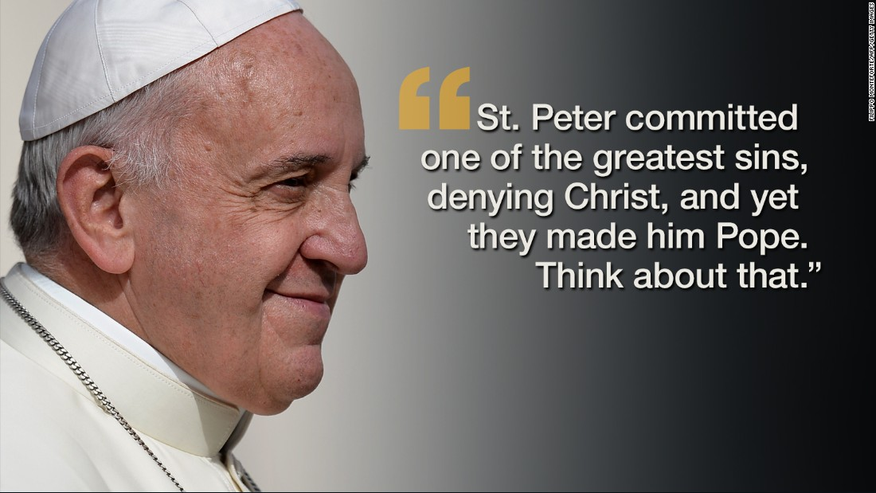
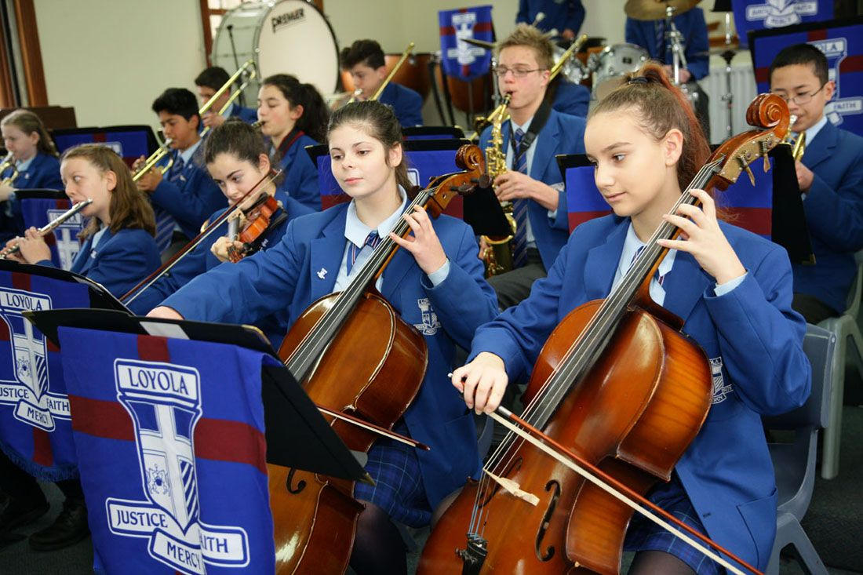

Slide 16
Intention: Loyola College, watsonia
All:
Lord Hear Our Prayer
Loyola College, Watsonia:
Lord, we pray that we have the compassion to forgive others their sins.
Like Jesus forgave Peter, we look towards virtue not vice.
We ask that we be compassionate in a world that so desperately needs it.
Lord Hear Us

Slide 17


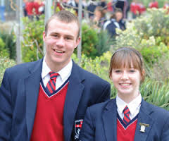

Slide 18
Intention: St Ignatius’ college, Geelong
All:
Lord Hear Our Prayer
St Ignatius’ College, Geelong:
Lord, we pray for justice.
That we pursue a society where all come to understand the justice of the Gospel
We ask that we be agents of justice in a world that so desperately needs it.
Lord Hear Us

Slide 19
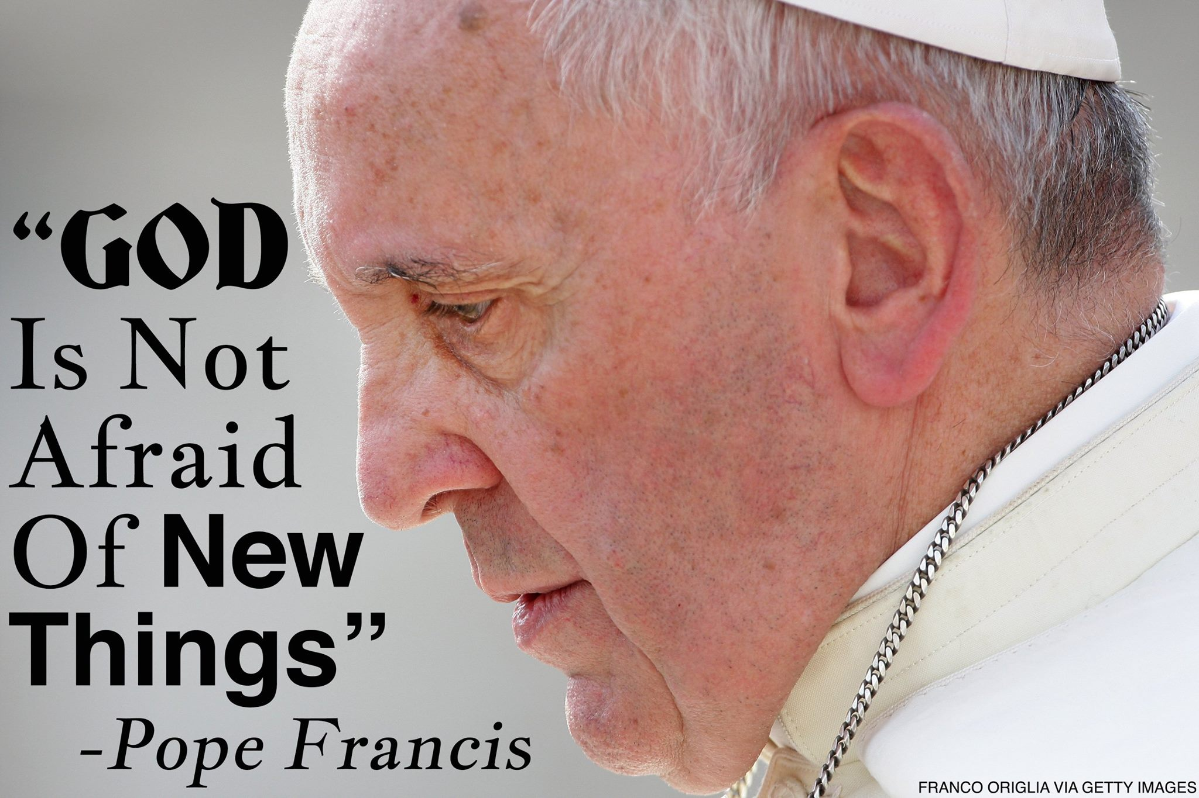

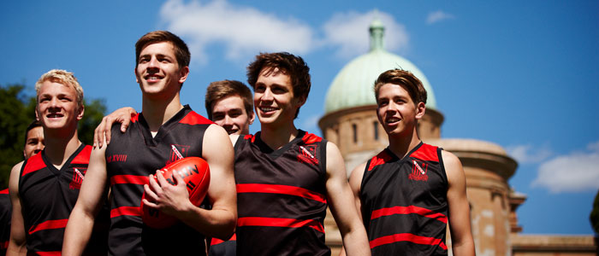

Slide 20
Intention: Xavier College, kew
All:
Lord Hear Our Prayer
Xavier College, Kew:
Lord, we pray for a willingness to open ourselves to the new and the untested.
We know that the Holy Spirit is continually calling us to cast out into the deep.
We ask that we be heralds of the Spirit in a world that so desperately needs it.
Lord Hear Us

Slide 21
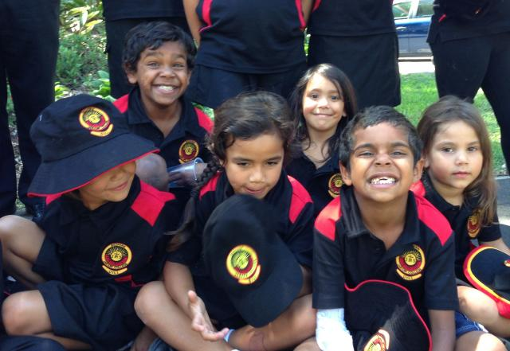



Slide 22
Intention: Redfern Jarjum College
All:
Lord Hear Our Prayer
Redfern Jarjum College:
Lord, we pray for the capacity to love as Jesus loved.
We know that to love another is to see the face of God.
We ask that we cultivate within our students hearts that burn with love for Jesus and for each other.
Lord Hear Us

Slide 23
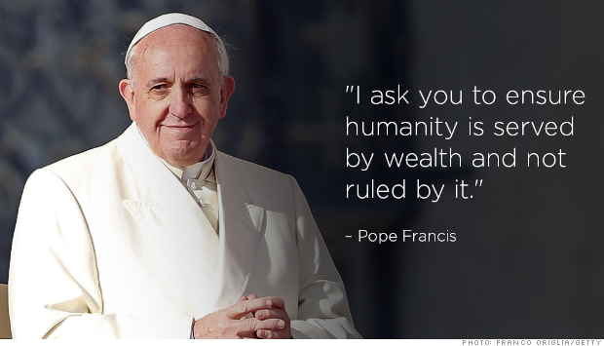



Slide 24
Intention: Xavier catholic College, ballina
All:
Lord Hear Our Prayer
Xavier College, Ballina:
Lord, we pray for our students as they leave our schools and enter the world.
That they grow to understand that happiness comes from serving others and not from serving wealth.
We ask that they be communicators of this truth within a world that so desperately needs it.
Lord Hear Us

Slide 25

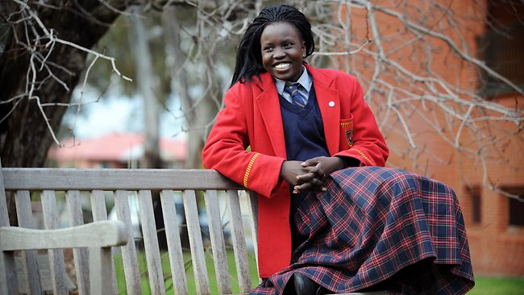


Slide 26
Intention: St Ignatius’ College, Adelaide
All:
Lord Hear Our Prayer
St Ignatius’ College, Adelaide:
Lord, we pray for the dispossessed, migrant and persecuted families of the world.
We pray that their peoples will have peace.
We ask that we be witnesses of hope in a world that so desperately needs it.
Lord Hear Us

Slide 27
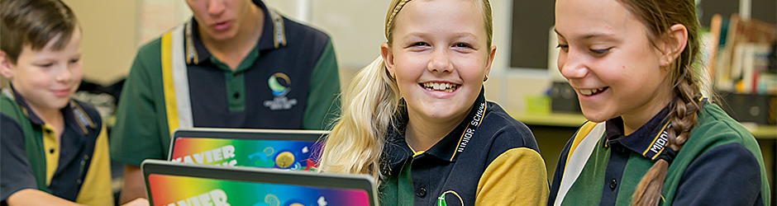
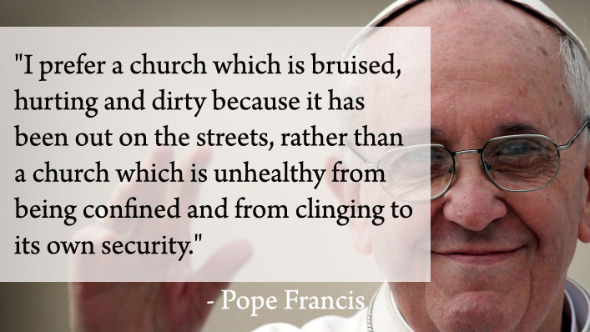


Slide 28
Intention: Xavier catholic College, hervey bay
All:
Lord Hear Our Prayer
Xavier Catholic College, Hervey Bay:
Lord, we pray for our school communities, that they are communities of inclusion where all are welcomed.
We know that we, as leaders of these communities, must demonstrate acceptance of difference.
We ask that our schools are beacons of companionship in a world that so desperately needs it.
Lord Hear Us

Slide 29

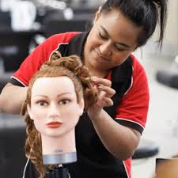


Slide 30
Intention: Loyola College, mount Druitt
All:
Lord Hear Our Prayer
Loyola College, Mount Druitt:
Lord, we pray for our students and for our colleagues who teach and support them.
We thank you for the blessing it is to teach your Good News.
We ask, in humility, that our students be people of goodness in a world that so desperately needs them.
Lord Hear Us

Slide 31
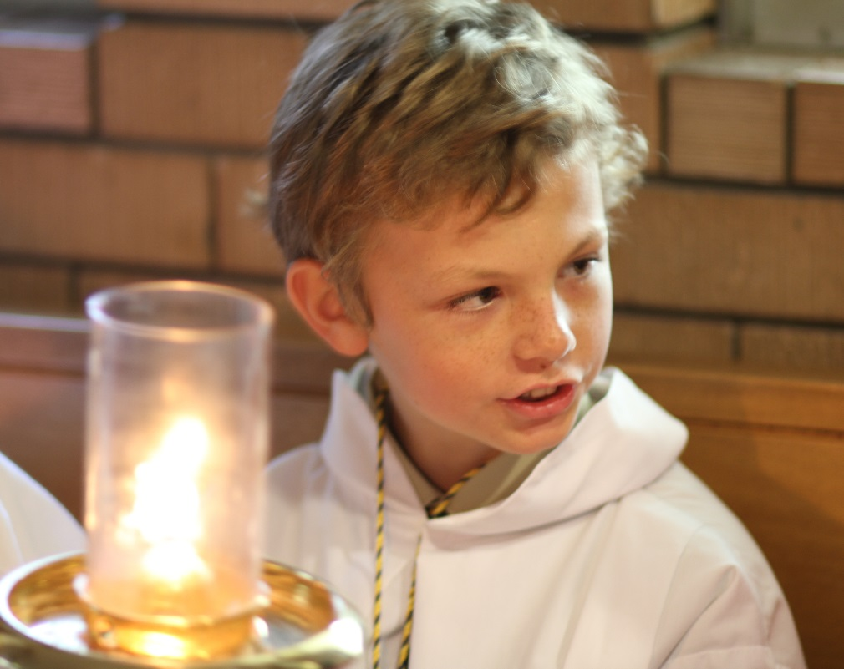
WE conclude our prayer
Blessed Mary Ward – PRAY FOR US
St Aloysius Gonzaga - PRAY FOR US
St Francis Xavier – PRAY FOR US
St Ignatius of Loyola – PRAY FOR US

