Slide 1
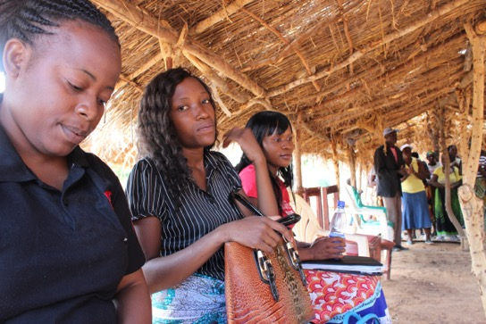
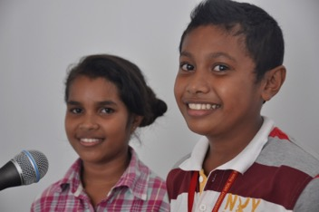
Service and Immersions
Key messages in preparing for immersions
Christopher Dureau - Xavier College - 7 July 2016

Slide 2
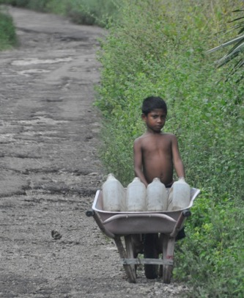
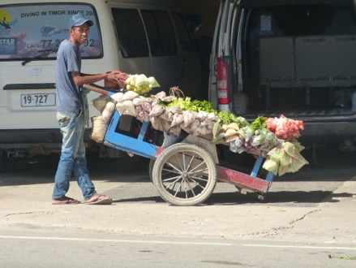
The Ignatian context -
Magis – Much not Many – Quality and depth not just quantity.
Option to be on the side of the Poor

Slide 3
‘Experiments’ in Ignatian Formation
Experiments: For whom, what and why?
Looking from the outside in – looking from the other side of my reality
Changing not only your ‘viewpoint but also your ‘standpoint’
Are immersion programs a modern version of this Ignatian Formation fundamental?

Slide 4
Assumptions & Immersion Experiences
Assumptions = patterns of thought that lead us to judge and act
We create our own future with the assumptions we make
Change begins with conversation with people who share or challenge assumptions
The way we speak and the words we use create the future we grow into. – words create worlds

Slide 5
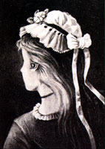
What we see is only a fraction of the whole reality
How can we see the same reality with different eyes?

Slide 6
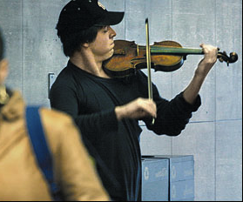
Joshua Bell in two different settings
Famous violinist charges $200+ per person at a packed concert in NY &
Next day: ‘Busks’ outside the metro
Nobody notices – nobody has eyes or ears to hear because at that time they were not open to the reality before them

Slide 7
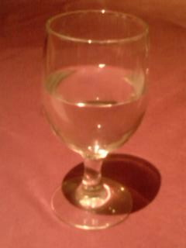
What has been your best experience ?
What experience or aspect of immersion has had the greatest impact on participants?
Why do you think this is so?
What are the key elements of this successful part of the immersion experience?
Group Discussion

Slide 8
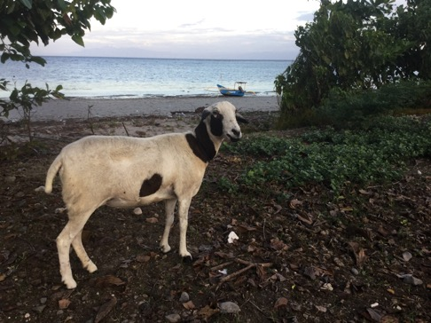
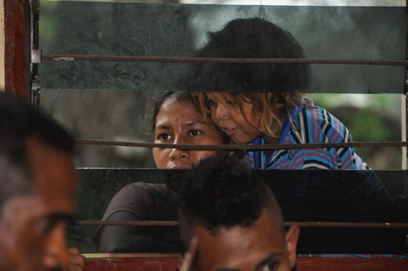
What are we (the organisers) looking for from an immersion experience?
Gather key points from the previous discussion
Revolving Brainstorm to spell these out into key messages?

Slide 9
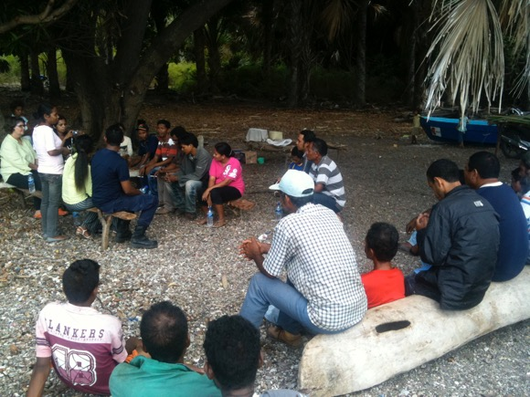
Key Points – Action Reflection
Inclusive discussions: ‘Don’t do anything to me without me’
Seeing things from the other’s perspective – Comparing the best of what you have with the best of what I have
Respect for others life choices and context – we are visiting their place.

Slide 10
More Key Points
Immersions are
For students who want to see their own lives differently
About going to places outside our own comfort zone – in a reflective manner
Are best when the learning opportunity is open to a range of possibilities
Are for those who aspire to values like equality, inclusiveness, justice and compassion.

Slide 11
Immersions are not suitable as:
Tourist time – time to relax
Time for new experience
What everyone does!
Other people said I should go.

Slide 12
The start of a conversation
What is important for a conversation to take place between adults?
Context
Attitude
Process
Outcome
What way do you start to talk about a context that is so different from your own:
What are the problems you are facing here or
What gives you home/ life/ reason to celebrate?

Slide 13
Starting a conversation - Practice
When we begin a conversation in a community
we have the choice to focus on:
Negative | Positive
What causes failure | What has succeeded
What is missing/needed | Where are the existing resources
What are the obstacles | What are the possibilities

Slide 14
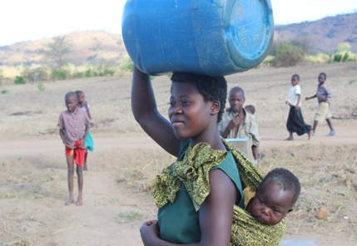
What people usually do is:
I am shocked that you live so poorly or
things are so bad around here compared to where I live:
Lets talk about what your needs are

Slide 15
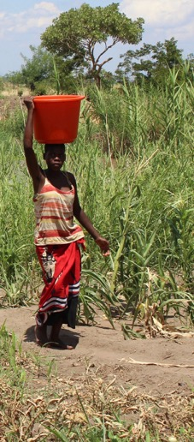
For a good immersion – we need to focus on what gives life to people we meet.
Do not focus on the issues they may be facing
Do you have any needs?
What is your problem?
How can your situation be better?
Focus on the strengths and reasons for joy
Why are things this good around here?
Who made it so?
What gives you hope for your future?
What are you hoping for now?

Slide 16
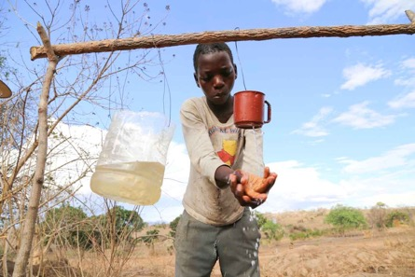
What people could do is:
I am sure there is plenty to celebrate and be happy about around here:
Lets talk about your lives and how things happen for you here
What has brought you to this point in your live – what has been your journey
What makes you proud? - What have been your successes?
What makes you happy? What gives you hope? …..

Slide 17
Lets talk about what you are proud of and what gives you life.
What are you good at
What have been your past successes and current strengths
How to you imagine your future
What works best around here
What makes things possible?

Slide 18
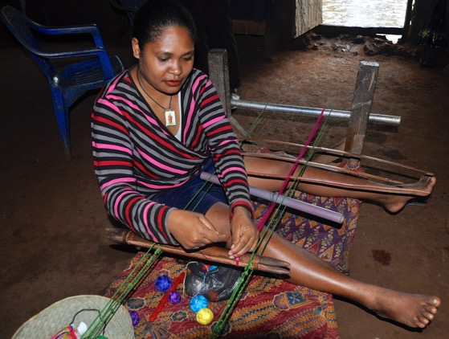
Head Heart Hand focus
A good way to organise your thinking in a conversations is to focus on three sorts of gifts people may have:
Gifts of the Head…..
Gifts of the Heart.....
Gifts of the Hands......

Slide 19
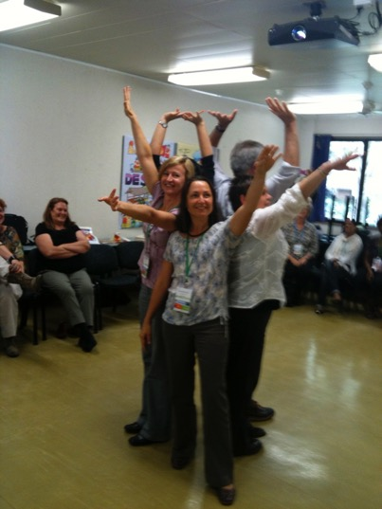
Pre-departure orientation
Logistics
Health & Safety
Understanding what is important
Whole body experience – hopes, fears, aspirations and expectations
Learning to suspend judgment and be open to new experiences

Slide 20
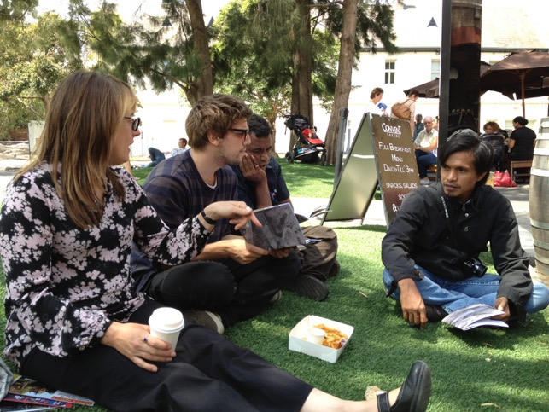
Immersion Reflection
An Emmaus experience ?
Reverse cultural shock is more pervasive
Reflection should include someone from the culture where the immersion took place
Focus on the positives – the friendships, the hope, the story of what is good
Focus on relationships rather than quick fixes as a way to move forward

Slide 21
Thank You
Christopher Dureau – Xavier College - 2016

